Slide 1
KEYLOGGER AND SECURITY
PRESENTED BY :
DIVYA S
CSE DEPARTMENT
PODHIGAI ENGINEERING COLLEGE

Slide 2
OUTLINE
Problem Statement (Should not include solution)
Proposed System/Solution
System Development Approach (Technology used)
Algorithm & Deployment
Result (Output Image)
Conclusion
Future Scope
References

Slide 3
PROBLEM STATEMENT
Keyloggers pose a significant risk to both individuals and organizations.
As they can surreptitiously record keystrokes and capture sensitive data.
Such as passwords, credit card numbers, and personal messages.
The challenge lies in implementing effective strategies to detect and mitigate.

Slide 4
PROPOSED SOLUTION
we propose a multi-faceted approach that combines technological solutions, user education, and proactive measures.
Advanced Anti-Malware Software :
Deploy advanced anti-malware software with built-in keylogger detection capabilities.
This software should use heuristic analysis and behavioral monitoring to identify suspicious activities indicative of keylogging behavior.
Regular updates and real-time scanning will ensure detection of new and emerging keylogger threats.

Slide 5
Endpoint Security Measures :
Implement endpoint security measures such as endpoint detection and response (EDR) solutions.
These tools provide visibility into endpoint activities and can detect and block unauthorized processes, including keyloggers, in real-time.
Network Traffic Analysis :
Utilize network traffic analysis tools to monitor incoming and outgoing traffic for signs of data exfiltration.
Keyloggers often attempt to transmit captured data to remote servers, and network monitoring can help identify and block these communication attempts.

Slide 6
Behavioral Analytics :
Employ behavioral analytics to identify anomalous user behavior that may indicate a keylogger infection.
By analyzing user activity patterns and deviations from normal behavior,
Organizations can detect and respond to keylogger incidents promptly.
User Education and Awareness:
Conduct regular security awareness training sessions to educate users.
The risks associated with keyloggers and best practices for preventing infection.

Slide 7
Continuous Monitoring and Incident Response:
Establish a comprehensive monitoring and incident response framework to detect, investigate, and mitigate keylogger incidents effectively.
Regulatory Compliance and Governance :
Ensure compliance with relevant regulations and industry standards governing data privacy and security.
Implement policies and procedures for data protection, encryption, and secure data handling practices.

Slide 8
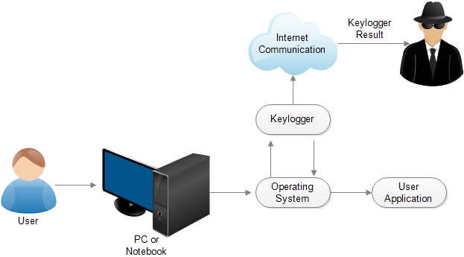
FLOW CHART

Slide 9
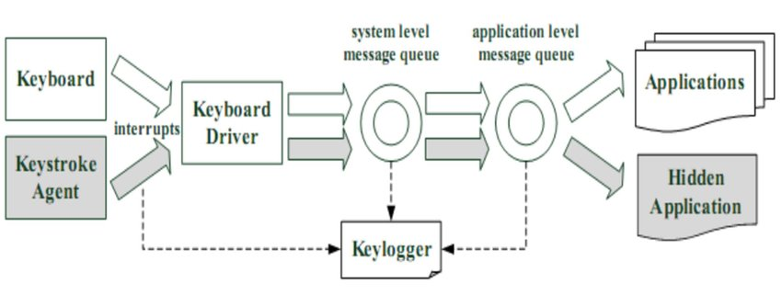
ARCHITECTURE DIAGRAM

Slide 10
SYSTEM APPROACH
The "System Approach" section outlines the overall strategy and methodology for developing and implementing.
System Components
System Interactions
System Goals
System Feedback and Improvement

Slide 11
ALGORITHM & DEPLOYMENT
Prevention Measures:
Implement user education programs to raise awareness about keylogger risks and safe computing practices.
Deploy endpoint security solutions with real-time scanning and heuristic analysis capabilities to detect and prevent keylogger installations.
Detection Algorithm:
Periodically scan system files, processes, and registry entries for known keylogger signatures using anti-malware software.
Monitor system logs and audit trails for unusual activities such as unauthorized access attempts or changes to system settings.

Slide 12
Mitigation and Response:
Upon detecting a keylogger, isolate the affected system from the network to prevent further data exfiltration or unauthorized access.
Deployment Planning:
Assess the organization's current security posture and identify keylogger-related risks and vulnerabilities.
Tool Selection and Configuration:
Choose appropriate anti-malware software, endpoint security solutions, and network monitoring tools based on the organization's requirements and budget constraints.

Slide 13
User Training and Awareness:
Conduct training sessions to educate users about keylogger risks, common attack vectors, and preventive measures.
Pilot Deployment:
Deploy keylogger detection and security measures in a controlled environment or pilot group to evaluate effectiveness and identify any implementation challenges.
Full-Scale Deployment:
Roll out keylogger detection and security measures across the organization's entire infrastructure, ensuring consistent implementation and adherence to security policies.

Slide 14
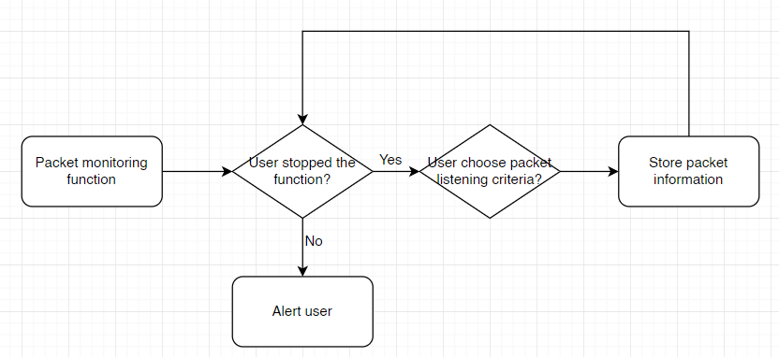
ALGORITHM

Slide 15
RESULT
A decrease in the number of keylogger infections observed across the organization's computing devices.
Fewer incidents of sensitive data leakage or unauthorized access attributed to keyloggers.
Enhanced capability to detect keylogger activity in real-time or during regular security scans.
Reduced incident response time due to early detection and mitigation of keylogger threats.
Minimized impact of keylogger incidents on organizational operations and data integrity.

Slide 16
CONCLUSION
Keylogger security requires a multifaceted strategy that encompasses prevention, detection, mitigation, user education, and continuous improvement.
Implementing advanced anti-malware software, endpoint security measures, network monitoring tools, and access controls forms the foundation of defense against keyloggers.

Slide 17
FUTURE SCOPE
Advanced Detection Techniques
Securing Emerging Technologies
Encryption and Data Protection
Behavioral Analysis and Threat Intelligence
User-Centric Security
IoT Security and Supply Chain Integrity
Cross-Sector Collaboration and Threat Sharing

Slide 18
REFERENCE
M. Rouse, "Keylogger (keystroke logger or system monitor)“.
E. Dulaney, "What Are Keyloggers, and How Do They Work?“.
M. Rouse, "Endpoint security“.

Slide 19


Slide 20
THANKYOU

